Slide 1
AI-Based Tool for Preliminary Diagnosis of Dermatological Manifestations
CSE7101- Capstone Project
Review-2
Batch Number : CSG_16
Under the Supervision of,
Dr. Harish Kumar K.S
Assistant Professor
School of Computer Science and Engineering
Presidency University
Roll Number | Student Name
20221CSG0020 | S MOHAMMED AFFAN
20221CSG0059 | KARTHIK MP
20221CSG0092 | CHAITHRA C
Name of the Program: CSG-Computer Science & Technology(AI ML)
Name of the HoD: Dr.Saira Banu
Name of the Program Project Coordinator: Dr. H M Manjula
Name of the School Project Coordinators: Dr. Sampath A K , Dr. Geetha A

Slide 2
Abstract
Skin diseases constitute a major global health burden, affecting millions of people annually and ranging from minor infections to severe cancers. Delayed diagnosis often leads to complications due to limited access to dermatologists, uneven distribution of specialists, and increasing patient loads. This project addresses the challenge by developing an AI-based tool for preliminary diagnosis of dermatological manifestations. The proposed system leverages deep learning, particularly Convolutional Neural Networks (CNNs) with transfer learning, to analyze skin lesion images and provide probable diagnoses with confidence scores and visual explanations. The key objectives are to enable early detection, risk prioritization, and timely referral, while serving as a decision-support system rather than a replacement for dermatologists. By combining automated image analysis with explainability features, the approach aims to improve accessibility, enhance clinical workflows, and reduce the burden on healthcare systems.

Slide 3
Literature Survey (10 papers)
Esteva et al. (2017) demonstrated dermatologist-level accuracy of CNNs in skin cancer classification.
Tschandl et al. (2018) introduced the HAM10000 dataset, providing a large multi-source collection of dermatoscopic images for skin lesion analysis.
Harangi (2018) showed that ensemble CNN models improve skin lesion classification accuracy and robustness.
Liu et al. (2025) proposed a multi-scale attention-based CNN achieving improved performance for general skin disease classification.
Pacheco & Krohling (2020) highlighted that integrating patient clinical information enhances automated skin cancer detection.
Mohan et al. (2024) demonstrated that transformer-based models with explainable AI achieve high accuracy and interpretability in skin disease classification.
Han et al. (2020) confirmed that ensemble deep learning methods boost skin lesion classification accuracy.
Xie et al. (2021) developed a lightweight CNN suitable for mobile-based skin disease diagnosis.
Goyal et al. (2020) applied Grad-CAM to provide explainable visualizations for CNN-based skin lesion classification.
Yu et al. (2021) evaluated fairness of AI dermatology models across skin tones, identifying potential biases in predictions.

Slide 4
Literature Survey
1. Esteva et al. (2017) – Dermatologist-Level Classification of Skin Cancer with Deep Neural Networks
Summary: This pioneering study demonstrated that deep neural networks could classify skin cancer images at a level comparable to dermatologists. The model was trained on a dataset of over 130,000 images, covering 2,032 different diseases.
Strengths: The large-scale dataset and the use of a deep convolutional neural network (CNN) architecture contributed to the model's high accuracy.
Limitations: The study primarily focused on melanoma and did not extensively cover other skin diseases. Additionally, the interpretability of the model was limited, which is crucial for clinical adoption.
2. Tschandl et al. (2018) – The HAM10000 Dataset
Summary: This paper introduced the HAM10000 dataset, a large collection of multi-source dermatoscopic images of common pigmented skin lesions, facilitating the development and benchmarking of skin lesion classification models.
Strengths: The dataset's diversity and size have made it a valuable resource for training and evaluating models.
Limitations: While extensive, the dataset may not encompass all skin conditions, potentially limiting the generalizability of models trained solely on it.

Slide 5
Literature Survey
3. Harangi (2018) – Skin Lesion Classification with Ensembles of Deep Convolutional Neural Networks
Summary: This study explored the use of ensemble learning techniques to improve the performance of skin lesion classification models. By combining multiple CNNs, the model achieved better accuracy and robustness.
Strengths: Ensemble methods can reduce overfitting and improve model generalization.
Limitations: Ensemble models can be computationally expensive and may not be suitable for real-time applications.
4. Liu et al. (2025) – A Skin Disease Classification Model Based on Multi-Scale Combined Efficient Channel Attention Module
Summary: This paper proposed a model that integrates multi-scale feature extraction with an efficient channel attention mechanism to enhance skin disease classification. The model demonstrated improved performance on the ISIC2019 and HAM10000 datasets.
Strengths: The incorporation of attention mechanisms allows the model to focus on relevant features, potentially improving accuracy.
Limitations: The model's complexity may lead to increased computational requirements.

Slide 6
Literature Survey
5. Pacheco and Krohling (2020) – The Impact of Patient Clinical Information on Automated Skin Cancer Detection
Summary: This study examined the influence of incorporating patient clinical information into automated skin cancer detection models. The findings suggested that combining clinical data with image data could enhance model performance.
Strengths: Integrating clinical information can provide a more comprehensive understanding of the patient's condition.
Limitations: The reliance on clinical data may raise privacy concerns and require additional data collection efforts.
6. Mohan et al. (2024) – Enhancing Skin Disease Classification Leveraging Transformer-Based Deep Learning Architectures and Explainable AI
Summary: This paper explored the use of transformer-based models, such as DinoV2, for skin disease classification. The study highlighted the model's high accuracy and F1-score, along with its interpretability using Grad-CAM and SHAP.
Strengths: Transformer models have shown promise in capturing long-range dependencies in image data.
Limitations: Transformer models can be computationally intensive and may require large amounts of data for training.

Slide 7
Literature Survey
7. Han et al. (2020) – Classification of Skin Lesion Images with Ensemble Methods and Deep Learning
Summary: This study investigated the use of ensemble methods combined with deep learning for skin lesion classification. The approach aimed to improve classification accuracy by leveraging the strengths of multiple models.
Strengths: Ensemble methods can enhance model robustness and reduce variance.
Limitations: The increased complexity of ensemble models can lead to higher computational costs.
8. Xie et al. (2021) – A Lightweight CNN Model for Mobile Skin Disease Diagnosis
Summary: This paper presented a lightweight CNN model designed for mobile devices, enabling on-the-go skin disease diagnosis. The model aimed to balance accuracy with computational efficiency.
Strengths: Mobile-friendly models can facilitate widespread access to skin disease diagnostics.
Limitations: The simplified model architecture may compromise performance compared to more complex models.

Slide 8
Literature Survey
9. Goyal et al. (2020) – AI-Based Explainability for Skin Lesion Classification Using Grad-CAM
Summary: This study focused on enhancing the interpretability of skin lesion classification models using Grad-CAM, providing visual explanations for model predictions.
Strengths: Explainable AI techniques can build trust in automated diagnostic systems.
Limitations: The quality of explanations may vary depending on the model's complexity and the techniques used.
10. Yu et al. (2021) – Evaluating Fairness in AI Dermatology Models Across Skin Tones
Summary: This paper assessed the fairness of AI dermatology models across different skin tones, highlighting potential biases and suggesting improvements for equitable model performance.
Strengths: Addressing fairness ensures that AI models provide accurate diagnoses for diverse populations.
Limitations: Achieving fairness may require extensive and diverse datasets, which can be challenging to obtain.

Slide 9
Literature Survey (10 papers)
Study | Dataset(s) | Model Type | Key Innovation | Performance Metrics | Limitations
Esteva et al. (2017) | Private | CNN | Large-scale training | High accuracy | Limited disease coverage
Tschandl et al. (2018) | HAM10000 | - | Dataset introduction | - | Dataset limitations
Harangi (2018) | Private | CNN Ensemble | Ensemble learning | Improved accuracy | Computational cost
Liu et al. (2025) | ISIC2019, HAM10000 | CNN with Attention | Multi-scale attention | 77.6% (ISIC), 88.2% (HAM10000) | Model complexity
Pacheco & Krohling (2020) | Private | CNN | Clinical data integration | - | Data privacy concerns
Mohan et al. (2024) | 31-class dataset | Transformer (DinoV2) | Transformer architecture | 96.48% accuracy, 0.9727 F1-score | Computational intensity
Han et al. (2020) | Private | CNN Ensemble | Ensemble methods | - | Higher computational cost
Xie et al. (2021) | Private | Lightweight CNN | Mobile optimization | - | Reduced performance
Goyal et al. (2020) | Private | CNN | Grad-CAM explainability | - | Explanation quality variability
Yu et al. (2021) | Private | CNN | Fairness evaluation | - | Dataset diversity challenges

Slide 10
Objectives
Develop an AI-based diagnostic tool capable of analyzing dermatological images and generating preliminary diagnoses with at least 90% classification accuracy.
Implement transfer learning using CNN architectures (e.g., EfficientNet, ResNet) to achieve fast and reliable predictions even with limited datasets.
Integrate explainability techniques (Grad-CAM/heatmaps) to provide visual justifications for model predictions, improving trust among clinicians and users.
Evaluate performance across diverse skin tones and conditions, ensuring fairness and generalization of the system by testing with benchmark datasets like HAM10000 and ISIC.
Deploy a lightweight prototype on web platform to demonstrate real-time usability in tele-dermatology and community healthcare settings.

Slide 11
Existing Methods and Drawbacks
Over the past decade, AI-based approaches for skin disease detection have shown remarkable accuracy, particularly in distinguishing melanoma from benign lesions. Most of these systems rely on deep learning models trained on benchmark datasets such as HAM10000 and ISIC, achieving performance levels comparable to dermatologists under controlled conditions. However, these methods generally concentrate on a narrow set of conditions rather than covering the wide variety of dermatological manifestations encountered in real clinical practice. Another major drawback lies in their dependence on dermoscopic images, which are captured under controlled lighting and magnification, limiting their ability to generalize to everyday clinical or smartphone photographs. Furthermore, the lack of demographic diversity in training datasets—especially the underrepresentation of darker skin tones—raises concerns about fairness and bias, leading to reduced diagnostic reliability across populations. In addition, while many studies report high accuracy, very few incorporate explainability features, making it difficult for clinicians to trust and validate the model’s decision-making process. These limitations highlight the need for more inclusive, interpretable, and deployable solutions that go beyond the lab setting and can support real-world healthcare environments.

Slide 12
Proposed Method & Feasibility Study
The proposed project focuses on building an AI-based tool for preliminary dermatological diagnosis by combining deep learning with explainable AI. The workflow begins with the collection of a large and diverse dataset of skin lesion images, including both dermoscopic and clinical photographs, to ensure that the system can recognize a wide spectrum of conditions across different skin tones and age groups. Preprocessing techniques such as image enhancement, segmentation, and normalization will be applied to minimize noise and handle variations in lighting or image quality. Feature extraction and classification will be carried out using Convolutional Neural Networks, while transfer learning with established architectures such as ResNet or EfficientNet will be utilized to improve performance and reduce training time. To build user trust, explainable AI methods like Grad-CAM will be integrated, providing visual heatmaps along with confidence scores for each prediction.

Slide 13
Proposed Method & Feasibility Study
The innovation of this project lies in its goal to design a generalized diagnostic system capable of identifying multiple dermatological manifestations, unlike existing models that are often disease-specific or biased toward certain datasets. The system emphasizes inclusivity by ensuring robust performance across diverse skin tones, while also integrating interpretability features that empower both healthcare providers and patients to trust the results. Instead of acting as a replacement for dermatologists, the tool functions as a decision-support system, improving triage, early detection, and timely referral.
In terms of feasibility, the project is well justified both technologically and economically. Open-source frameworks such as TensorFlow and PyTorch eliminate licensing costs, while transfer learning reduces the need for expensive hardware by enabling training on affordable GPU-enabled systems or cloud platforms. Deployment as a lightweight web application further ensures accessibility without requiring high-end devices. By leveraging widely available datasets such as HAM10000 and ISIC, the development cost and data collection effort are minimized, making the system practical, resource-efficient, and suitable for real-world healthcare environments.

Slide 14
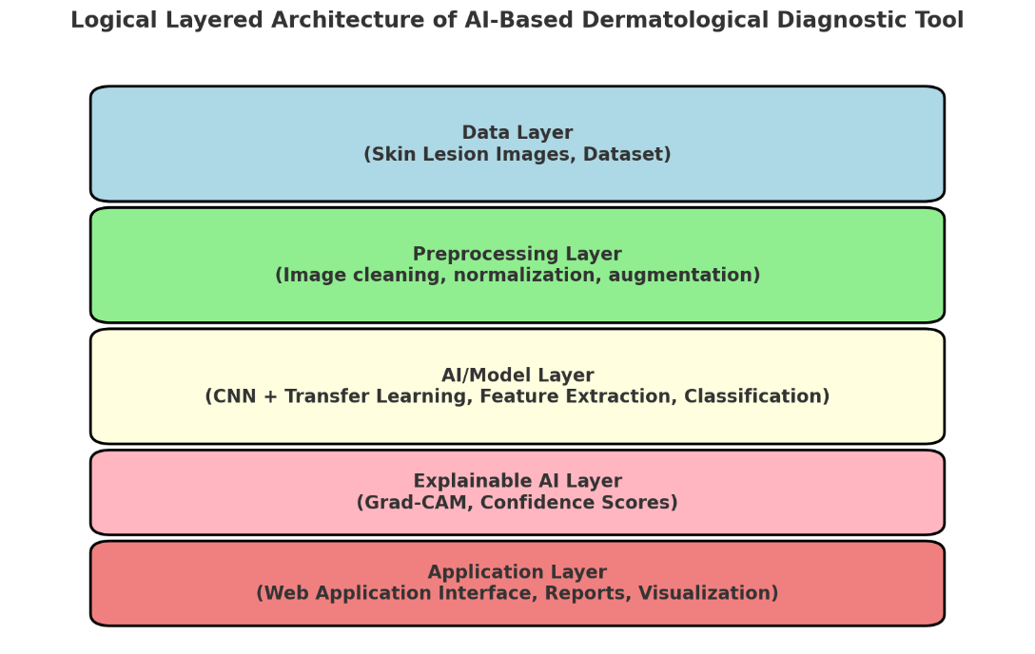
Architecture Diagram

Slide 15
Architecture Diagram
Data Layer: Collects and stores dermatological images from datasets (e.g., HAM10000) covering diverse conditions and skin tones.
Preprocessing Layer: Cleans images, removes noise, normalizes resolutions, and applies augmentation to improve model robustness.
AI/Model Layer: Uses CNNs with transfer learning (e.g., ResNet, EfficientNet) for feature extraction and classification of skin lesions.
Explainable AI Layer: Integrates methods like Grad-CAM to highlight lesion areas, providing confidence scores and visual reasoning for predictions.
Application Layer: A web-based interface where patients and healthcare professionals can upload images, view results, and access diagnostic reports.

Slide 16
Modules

Slide 17
Technology Stack Components
Programming Languages: Python (for AI/ML models), JavaScript/React (for web)
AI/ML Libraries: TensorFlow / PyTorch, Keras, OpenCV (for image preprocessing)
Frameworks: Flask / FastAPI (for backend)
Databases: MySQL / MongoDB (for patient data and model outputs)
Cloud Platforms: AWS / Google Cloud / Azure for hosting and model deployment
Visualization: Grad-CAM or LIME for explainable AI heatmaps

Slide 18
Software Requirements
OS: Windows / Linux / macOS (for development)
Development Tools: Jupyter Notebook, PyCharm / VS Code
Libraries: TensorFlow, PyTorch, OpenCV, scikit-learn, NumPy, Pandas, Matplotlib
Web Tools: Node.js, React.js (for frontend), Flask/FastAPI (for backend APIs)

Slide 19
Github Link
https://github.com/Stu-Affan/Capstone-Project/tree/main

Slide 20
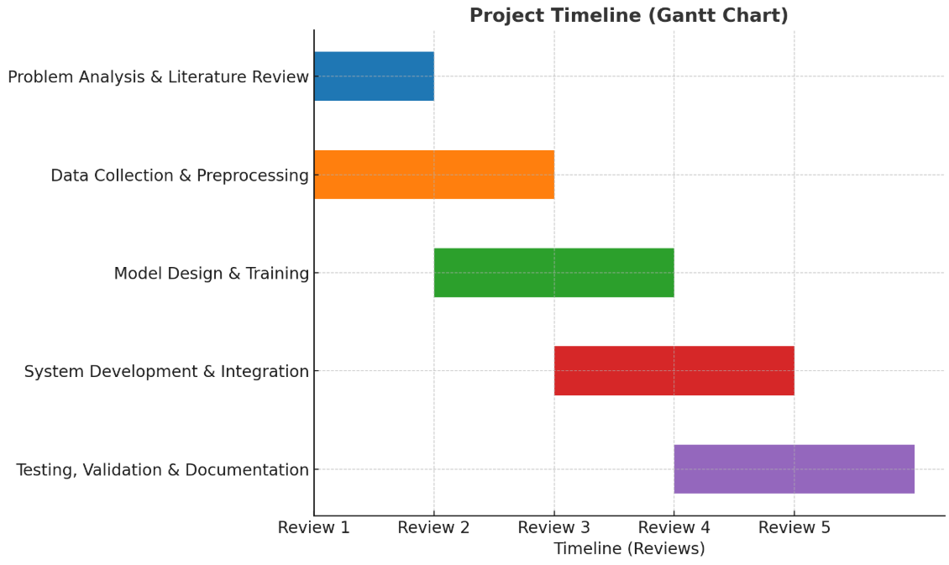
Timeline of the Project (Gantt Chart)

Slide 21
References (IEEE Paper format)
[1] A. Esteva, B. Kuprel, R. A. Novoa, J. Ko, S. M. Swetter, H. M. Blau, and S. Thrun,
“Dermatologist-level classification of skin cancer with deep neural networks,” Nature, vol. 542, no. 7639, pp. 115–118, Feb. 2017.
https://doi.org/10.1038/nature21056
https://www.andreesteva.com/assets/nature_skincancer.pdf
[2] P. Tschandl, C. Rosendahl, and H. Kittler, “The HAM10000 dataset, a large collection of multi-source dermatoscopic images of common pigmented skin lesions,” Scientific Data, vol. 5, p. 180161, 2018.
https://www.nature.com/articles/sdata2018161
[3] Balazs Harangi , “Skin lesion classification with ensembles of deep convolutional neural networks,” Journal of Biomedical Informatics, vol 86, pg.25-32, Oct 2018.
https://doi.org/10.1016/j.jbi.2018.08.006

Slide 22
References (IEEE Paper format)
[4] H. Liu, Y. Zhang, and X. Zhang, “A skin disease classification model based on multi-scale combined efficient channel attention module,” Scientific Reports, vol. 15, no. 6116, 2025. https://www.nature.com/articles/s41598-025-90418-0
[5] R. Pacheco and C. Krohling, “The impact of patient clinical information on automated skin cancer detection,” Comput. Biol. Med., vol. 116, p. 103545, 2020. https://doi.org/10.1016/j.compbiomed.2019.103545
[6] J. Mohan, A. Sivasubramanian, V. Sowmya, and R. Vinayakumar, “Enhancing skin disease classification leveraging transformer-based deep learning architectures and explainable AI,” arXiv, 2024. https://arxiv.org/abs/2407.14757
[7] H. Han, S. Moon, H. Kim, S. Oh, and J. Park, “Classification of skin lesion images with ensemble methods and deep learning,” IEEE Access, vol. 8, pp. 118–127, 2020. https://doi.org/10.1109/ACCESS.2020.2967488

Slide 23
References (IEEE Paper format)
[8] F. Xie, Q. Liu, S. Zhang, and J. Liu, “A lightweight CNN model for mobile skin disease diagnosis,” Pattern Recognit. Lett., vol. 144, pp. 27–34, 2021. https://doi.org/10.1016/j.patrec.2020.12.005
[9] M. Goyal, A. Kaur, and R. K. Jha, “AI-based explainability for skin lesion classification using Grad-CAM,” Diagnostics, vol. 10, no. 12, p. 1092, 2020. https://doi.org/10.3390/diagnostics10121092
[10] K. Yu, M. M. Yan, A. M. Long, C. K. Chen, and L. L. Wong, “Evaluating fairness in AI dermatology models across skin tones,” npj Digit. Med., vol. 4, p. 139, 2021. https://doi.org/10.1038/s41746-021-00492-0

Slide 24


